Slide 1
Horizontal vs Vertical Scaling
Mundru Yallamanda Rao (2019201029)
Issac Balaji (20163051)
Sonu Guru (2018101004)

Slide 2
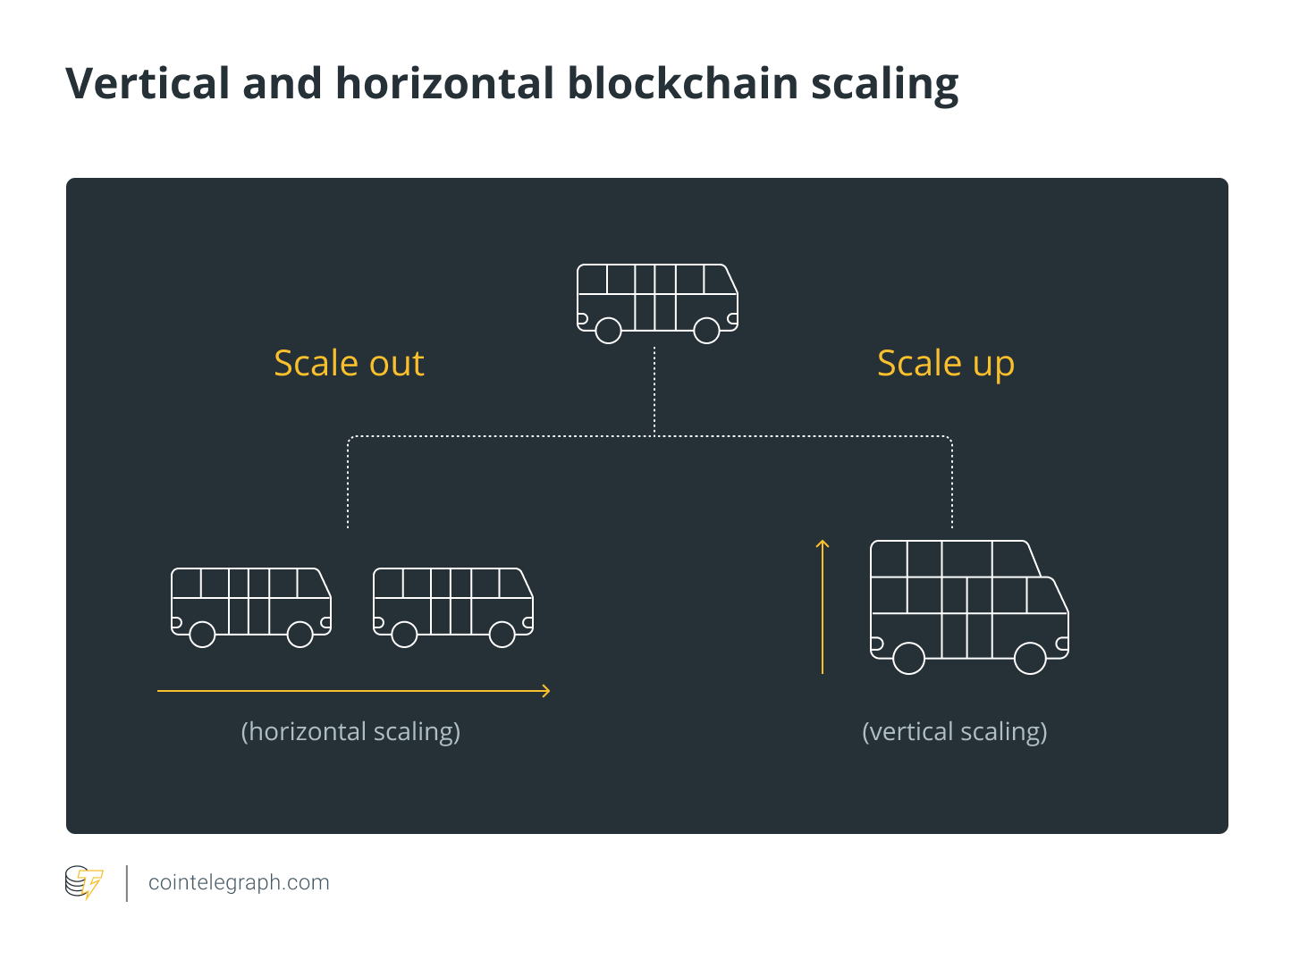
Scalability
Scalability is the property of a system to handle a growing amount of work by adding resources to the system.

Slide 3
Scalability
From computing perspective, scalability can be seen in terms of networks, algorithms, networking protocols, programs and applications. We can scale the system in two ways:
Horizontal Scaling (Scale out)
Vertical Scaling (Scale up)
Scaling horizontally and scaling vertically are similar in that they both involve adding resources to our infrastructure. They differ in terms of implementation and performance.

Slide 4
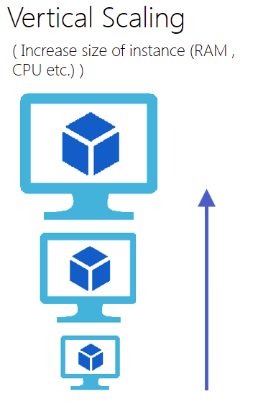
Vertical Scaling
We increase the capacity of a single machine.
Here the resources such as processing power,
storage, memory, and more are added to an
existing work unit.
Example of Vertical Scaling:
MySQL and Amazon RDS.

Slide 5
Vertical Scaling
Advantages :
Easy to Implement.
Consumes less power.
Less administrative efforts as you need to manage just one system.
Inter process communication is faster.

Slide 6
Vertical Scaling
Disadvantages :
Limited Scaling.
Single point of failure.
The risk for downtime is much higher than horizontal scaling.
Greater risk of outages and hardware failures.
As requirements increase, cost of implementing increases exponentially.

Slide 7
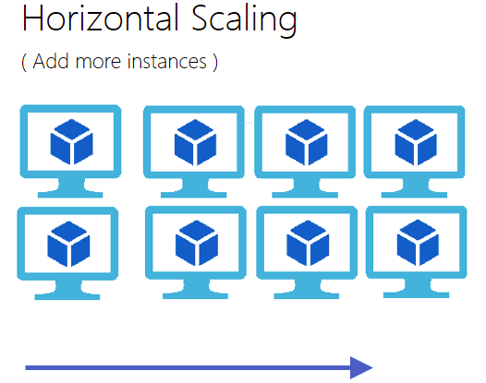
Horizontal Scaling
Horizontal scaling involves scaling by adding more machines to our pool of resources.
Horizontal scaling requires breaking
a sequential piece of logic into smaller
pieces so that they can be executed in
parallel across multiple machines.
Example of horizontal scaling:
Cassandra and MongoDB

Slide 8
Horizontal Scaling
Advantages :
Since the load is distributed across multiple systems, horizontal scaling is more resistant to system failure.
Easy to upgrade (no downtime)
Cost of implementing is less expensive compared to vertical scaling.
Infinite Scale, can use an endless number of instances to enable limitless growth.

Slide 9
Horizontal Scaling
Disadvantages :
Architectural design is highly complicated.
High licensing fees.
High utility costs such (cooling and electricity).
Extra networking equipment such as routers and switches are required.

Slide 10
Comparison
Horizontal Scaling
Vertical Scaling
Here the lack of a shared address space makes data sharing more complex. It also makes the process of sharing, passing or updating data more costly since you have to pass copies of the data. | Here there exist a shared address space, so data sharing and message passing can be done by passing a reference.
In Horizontal scaling we have to achieve concurrency between jobs that are distributed across machines over the network. | Concurrent programming on multi-core machines is often performed via multi-threading and in-process message passing.
Message Passing
Concurrency

Slide 11
Comparison
Horizontal Scaling
Vertical Scaling
Load balancers are required to evenly distribute data across multiple machines in the network. | No load balancing is required.
In Horizontal scaling adding more machines to the existing pool means you are not entirely dependent on a single unit, making it possible to scale or cope with system failures with less downtime. | Vertical scaling is limited to the capacity of one machine, this can lead to significant amount of downtime when there is system failure of scaling up system.
Load Balancing
Downtime

Slide 12
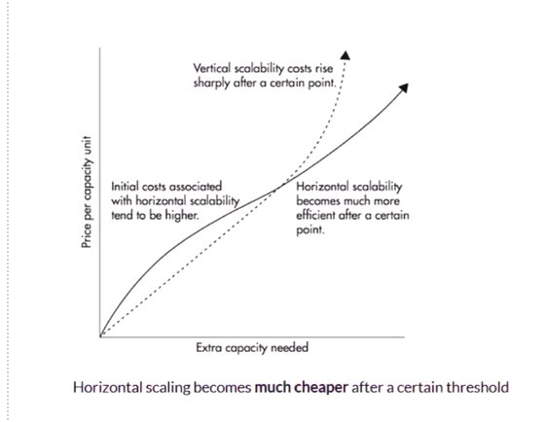
Comparison

Slide 13
Thank You

